Slide 1


Actuate iHub Visualization Platform For Corporate Online Banking
Notes:
In the Corporate Online Banking market, the primary decision maker for Treasury Services is the head of Treasury for the customer organization. However, it is this individual who rarely returns to experience the Corporate Online Banking application on an ongoing basis. In an effort to grow organically, customer retention is the initial step.

Slide 2
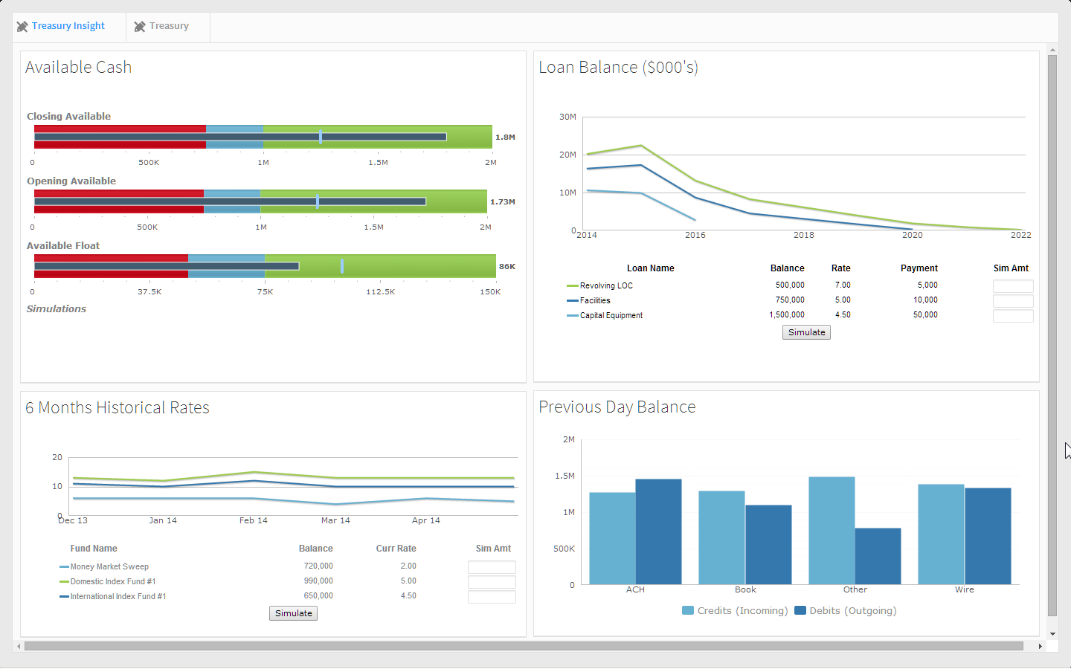
Notes:
Provides compelling high value interface.
This dashboard provides simulation capability for the users.

Slide 3
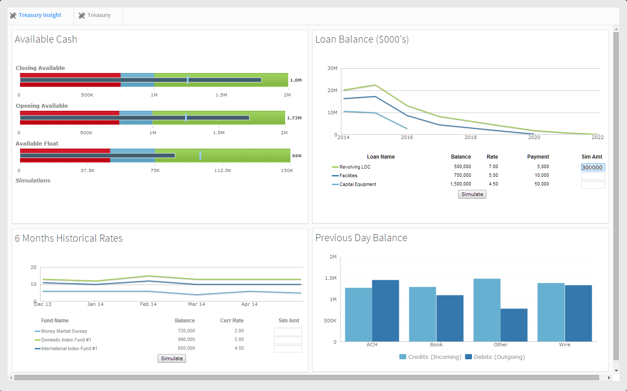
Notes:
In this example, we are going to roll some of the Available Closing cash into the Loan Balance Chart’s “Revolving LOC”, since that loan has the highest interest rate and longest maturity of year 2022.
Enter 300,000 into Revolving LOC's Sim Amt form field and hit enter. (This is hardwired for $300,000, so BE SURE to enter that value)
Click enter – (clicking enter causes the sim value field’s background color to change to lite blue)

Slide 4
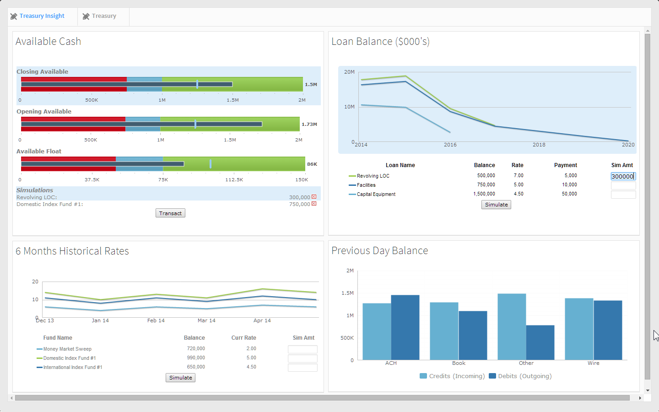
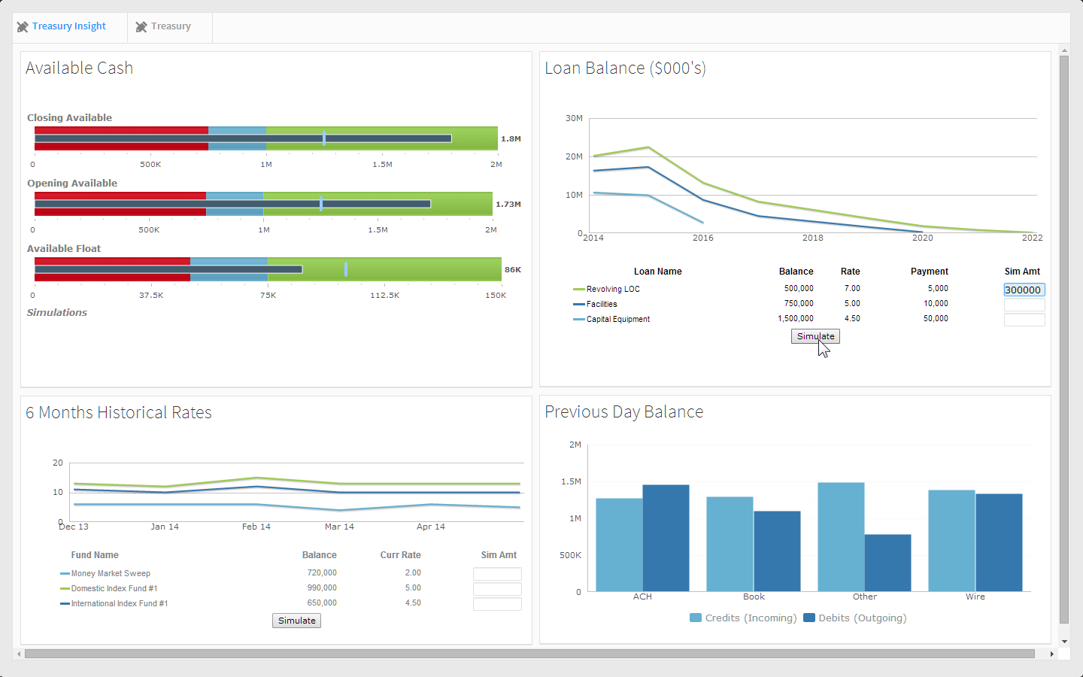
Notes:
Click simulate –
This sends the message to our available cash gadget via inter portlet communication (i.e. Google pub/sub).

Slide 5
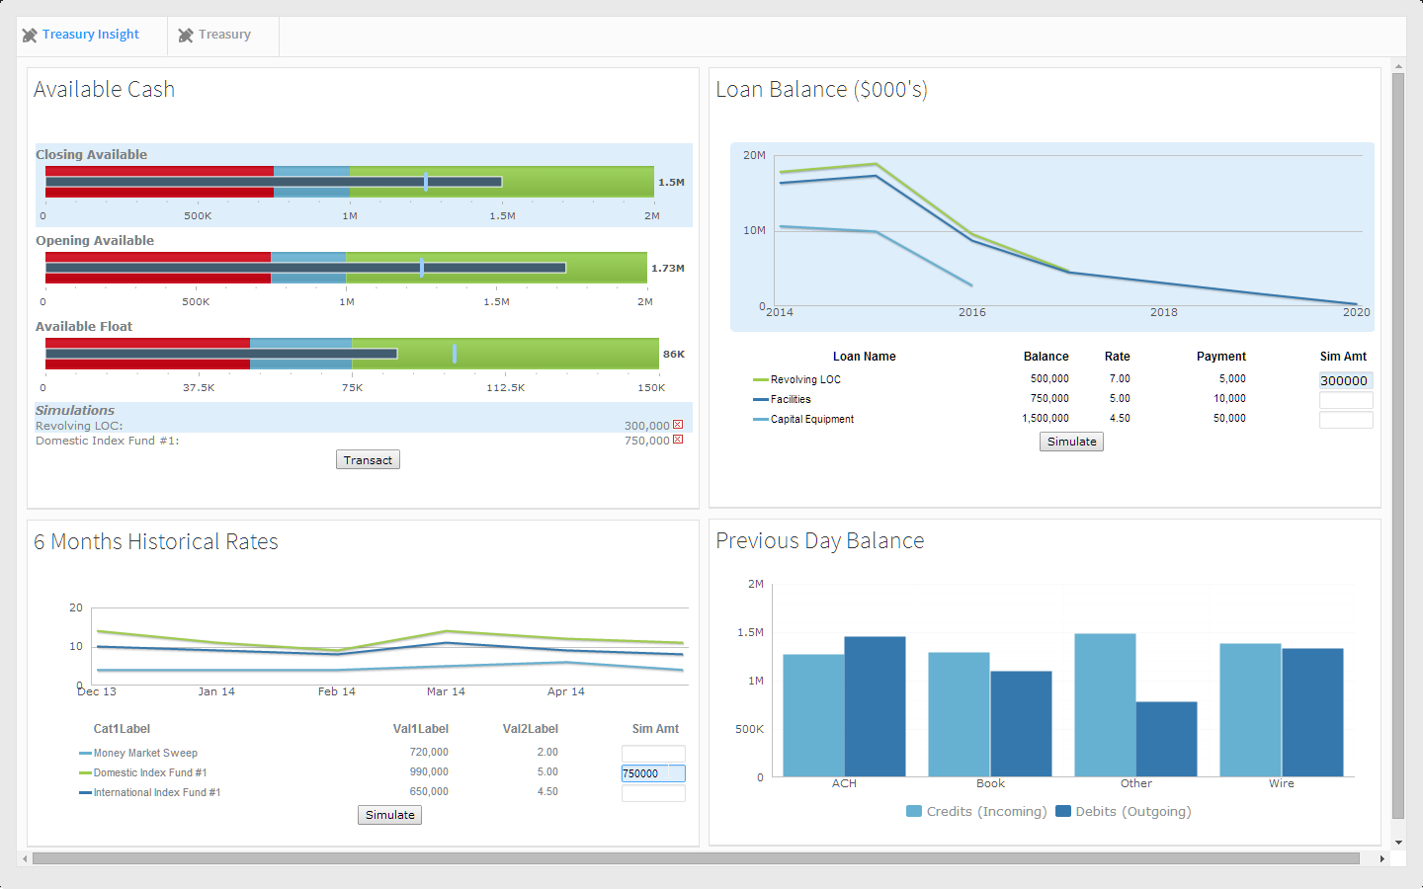
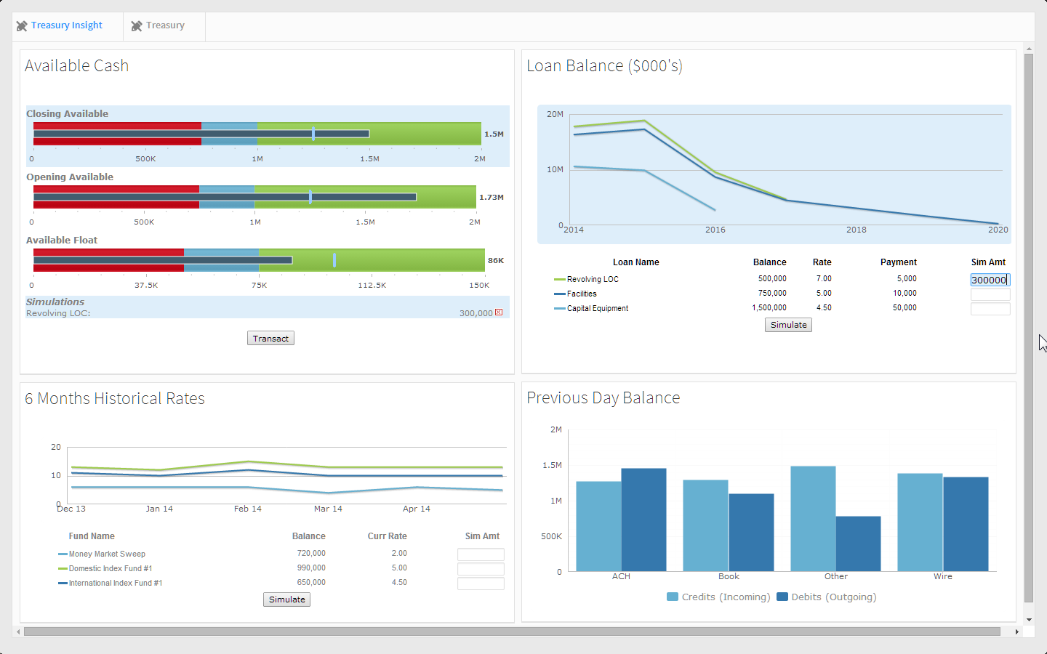
Notes:
Now all simulated changes have a light blue background. The Revolving LOC's maturity in the chart has moved from 2022 to 2017. In the Available Cash gadget, the Closing Available total has appropriately decremented from 1.8 million to 1.5 million. The simulated transaction displays here too.

Slide 6

Notes:
Let's sweep some Available Closing cash into Domestic Index Fund #1 shown in the 6 Months Historical Rates gadget. This fund’s 6 month historical view looks better than the other funds and it has the highest rate.
Enter 750,000 into Domestic Index Fund #1's Sim Amt form field and click ENTER. (Causes background of simulated field to turn blue)

Slide 7

Notes:
Click simulate
- Again clicking on simulate fires a message to the Available Cash gadget with the amount of the simulation.

Slide 8

Notes:
Now the Available Cash gadget’s Closing Available total has appropriately decremented by 750,000. Both simulated transactions are also displayed.

Slide 9
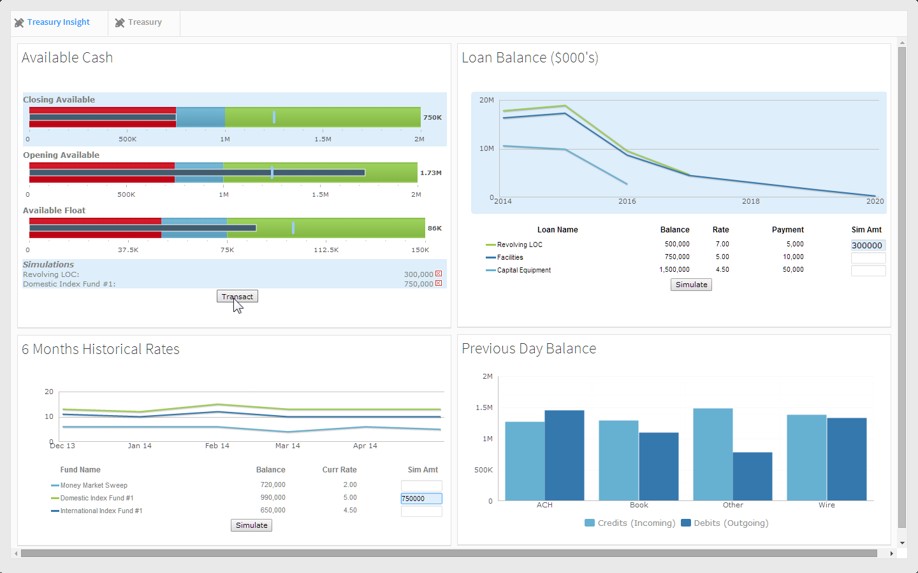
Notes:
The simulated transaction information can now be sent to internal core transaction systems to convert them into real transactions by clicking the Transact button.

Slide 10
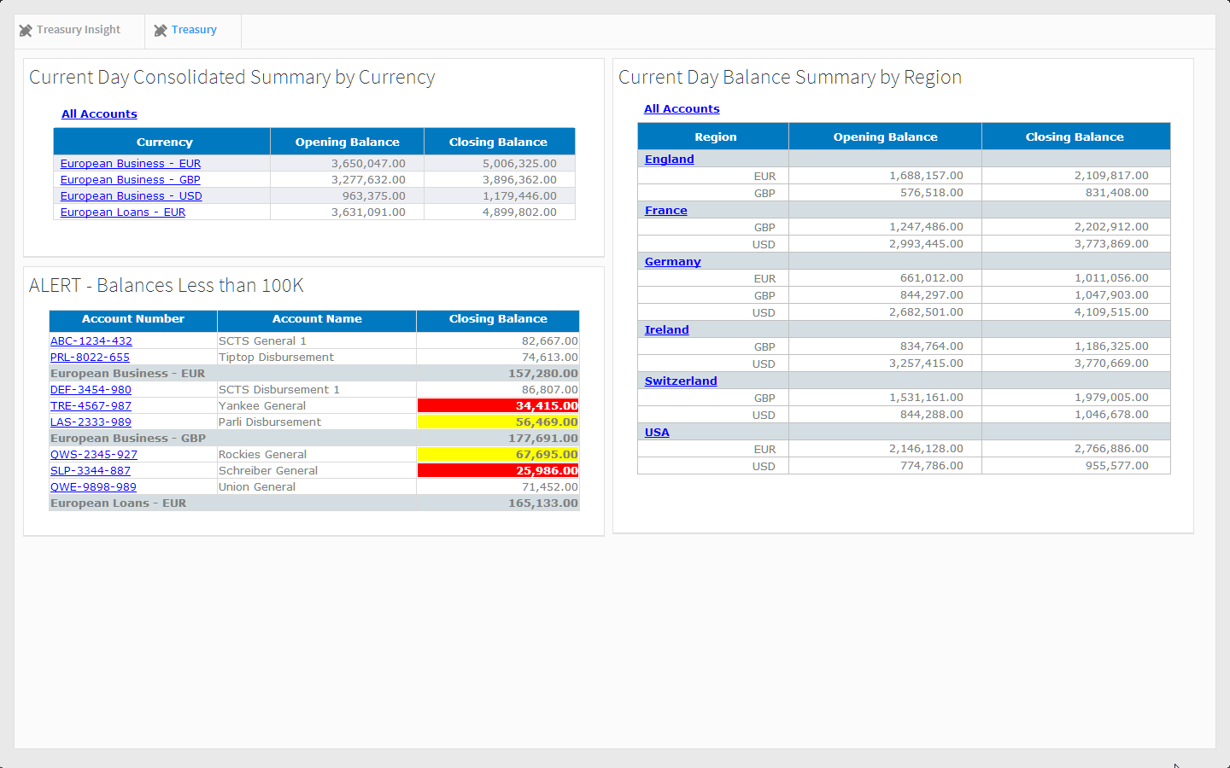

Slide 11
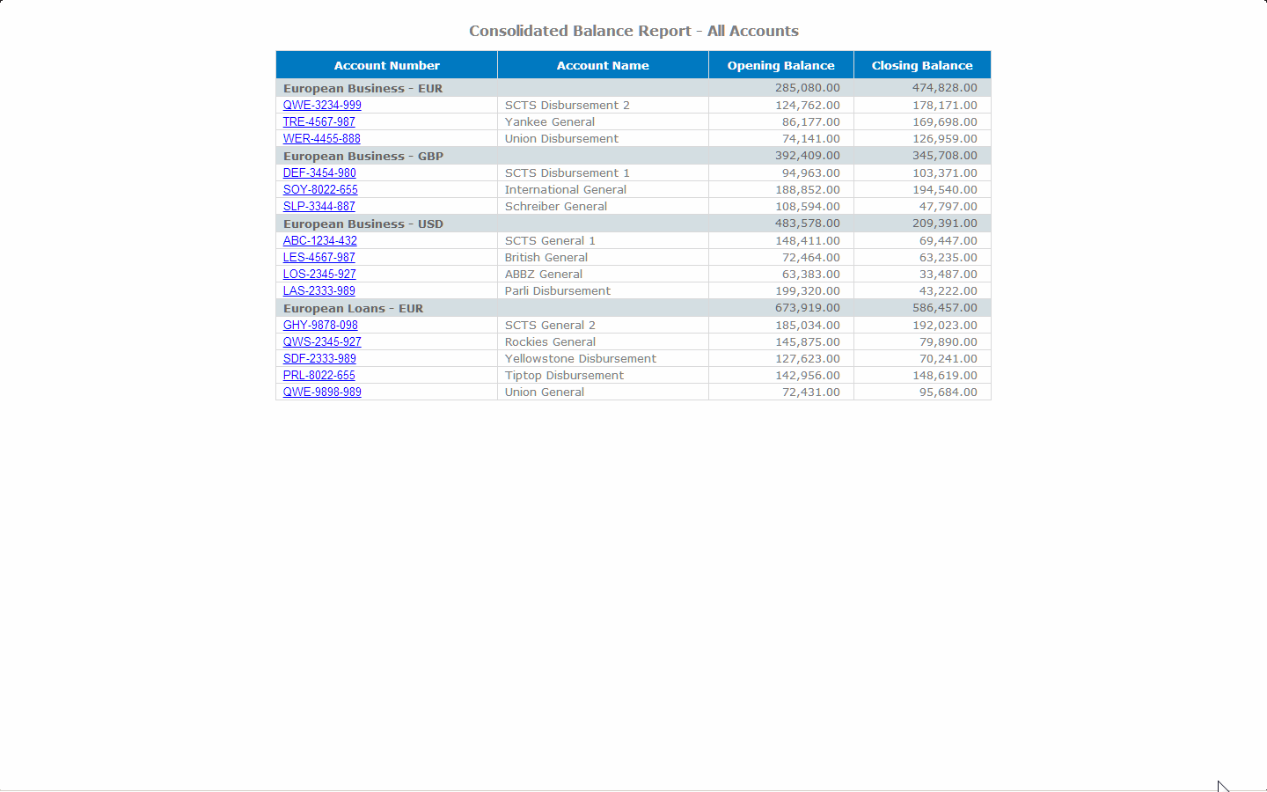
Notes:
Selecting All Accounts brings up the Consolidated Balance Report.
Select DEF-3454-980 which will bring up the excel report shown on the next screen shot.

Slide 12
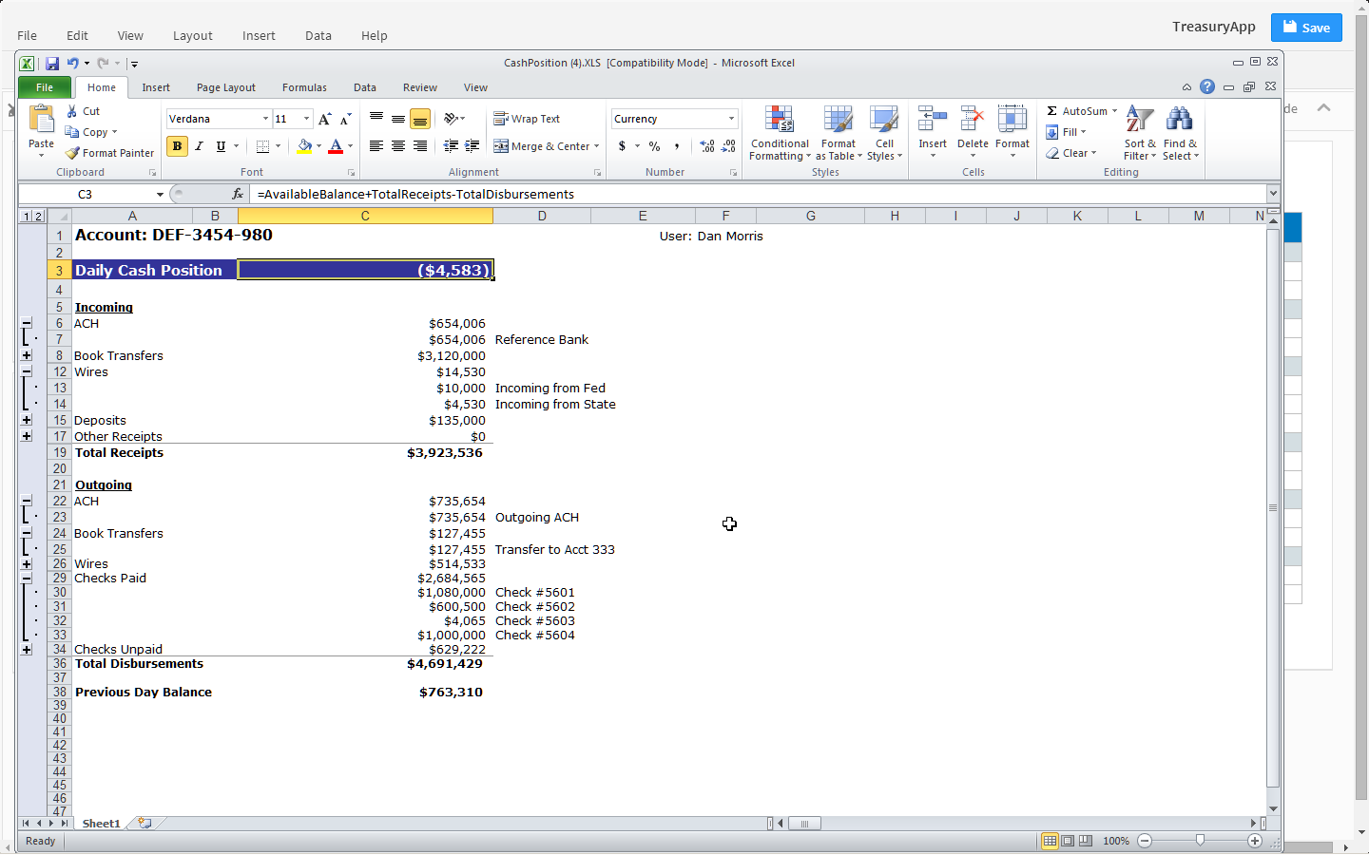

Slide 13
